Slide 1
CM4701 - Human Computer Interaction
Week 7: Practical Designs and Evaluation
Carlos Moreno-García

Slide 2
Practical Designs

Slide 3

Design
To design means
To make something concrete
The word also means to desire something
In the case of HCI, design means
To convert the findings of the user requirements study into a concrete proposal for the design of a system
This is the system that the users desire

Slide 4
Usability
Effectiveness
Learnability
Flexibility
Attitude
The new law is oriented towards health and safety and specifies standards for hardware and furniture, but also specifies how software should be made more usable!
Keep in mind accessibility and other issues!
Notes:
Security, prone to addictiveness, others!

Slide 5
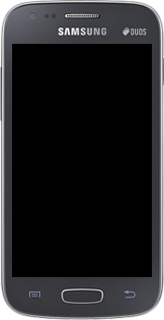
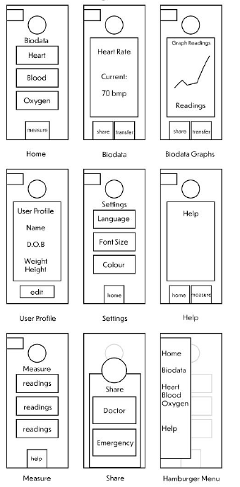





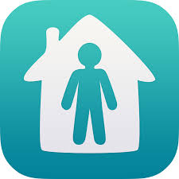
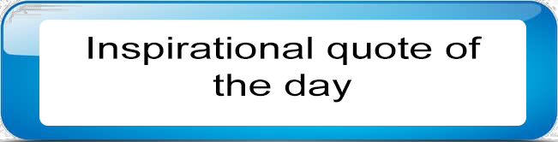
Examples of practical designs
Diet
Health sign stats
https://xd.adobe.com/view/040d3f8a-9695-4908-7899-ab2d655d5640-723c/?fullscreen&hints=off
BMI
Exercise
Profile
Home
https://youtu.be/BB18XlofqwM

Slide 6
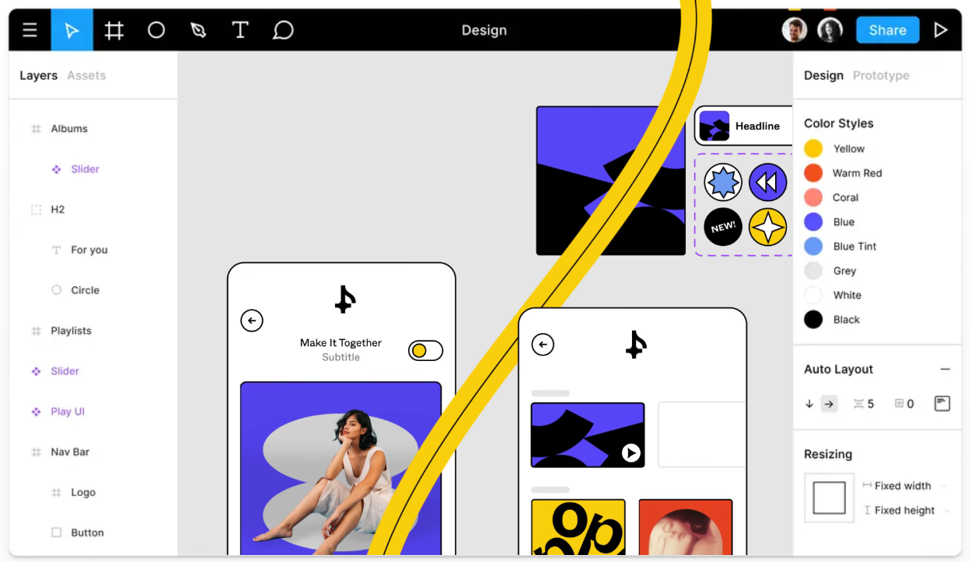
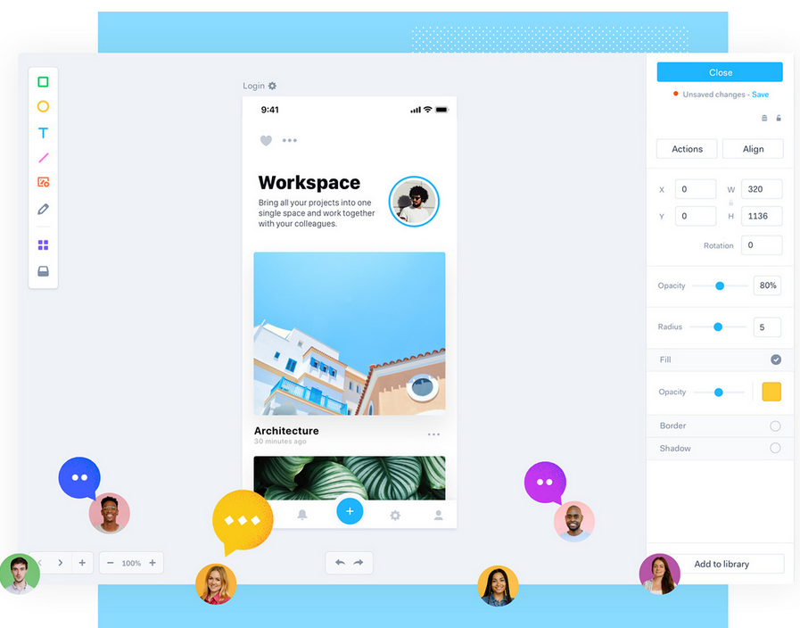
Tools for PD Design
Marvel app
Free trial version allows you for one design, so you would need to open two accounts!
Figma
The free version should be enough for you…
Adobe XD
Has a free trial, but if you already have access to Adobe Cloud products then use it!
Paint, PowerPoint, Photoshop, etc.

Slide 7
Demo (Marvel)
Go to Moodle to download the source files and to watch the video demo

Slide 8
Scenarios (+ walkthroughs)

Slide 9
Scenarios
We need a process of discovering things about users and how they use!
Descriptions of people using technology?
Scenario-Based Usability Engineering
User Interaction Scenarios

Slide 10
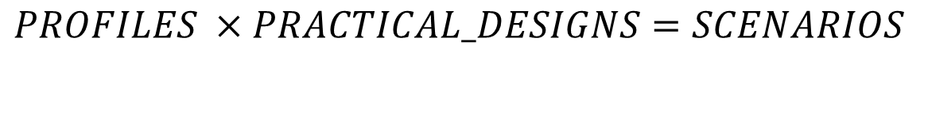
The Magic Formula
$$PROFILES ×PRACTICAL_DESIGNS=SCENARIOS$$
Notes:
How your profiles use your PRACTICAL designs

Slide 11
What is a scenario?
A scenario is a description of something
Stakeholders and users
Typical usage
Problems
Who writes scenarios?
Designers
Users
Designers and users - groups
Experts
Anybody who can provide information that is relevant

Slide 12
Are scenarios too simple?
Scenarios can give an impression of simplicity
A basic scenario is simple and is meant to be simple
Can be written by users with no technical skills or knowledge
Can be read and understood by everyone
Allows evaluation with users
Scenarios form the basis for more complex analysis
Claims analysis Pros and Cons of various features
Various analyses of situations and contexts
Formal task analysis
Further studies, including experiments

Slide 13
Key concepts in scenarios
Scenarios have components:
Setting
Actor(s)
Claims
Task Goals
Actions
Plans
Evaluation
Analysing Requirements (AR)
Setting + Actor(s) + Claims
Activity Design
AR + Task Goals + Evaluation
Information Design
AR + Plans + Evaluation
Interaction Design
AR + Actions + Evaluation

Slide 14
Scenario example w/ user feedback
You have created your scenarios and analysed your claims.
You are the designer and it is your informed perception that led you to create these scenarios
Time to ask potential user their feedback. You need to know what they think will work and will not work. What they like or did not like?
At the end of the process, you will know how your system is most likely to be received and how usable potential users think it will be.
Moreover, you will know the “bit” that you must review or change.
Notes:
We won’t do this in the CW

Slide 15
Scenario Example
You are testing an app that provides COVID guidelines if the “Trace and Protect” programme finds out that you may have caught the disease
Mary (user) is not technology-savvy, and she may not see the value of the app, therefore she may be apprehensive!
Problem: There is a danger that Mary finds the system patronising as she is (or feels she is) mildly affected.
Problem: Mary is reliant on someone else’s technical ability, and she may not trust herself to understand and set up the app.
Problem: If Mary thinks of something that needs to be added to the device reminders, she is not capable or able to, as she is does not know how to properly access the app.
Consequences
What happens if she forgets the device at home? Can she input/get info once she is back?

Slide 16

Walkthrough
For each task, a walkthrough considers…
• What impact will interaction have on the user?
• What cognitive processes are required?
• What learning problems may occur?
Analysis focuses on users goals and knowledge: does the design lead the user to generate the correct goals?
Notes:
This is more reliant on the app usage

Slide 17
Walkthroughs
Cognitive walkthroughs are used to examine the usability of a product
Designed to see whether or not a new user can easily carry out tasks within a given system or application
It is a task-specific approach to usability (i.e. relates to functionality)
Walkthroughs are sanity checks for your design
Examine and check the usability of a product.
See whether or not a new user can easily carry out tasks within a given system or application.
Task-specific approach to usability based on exposed functionality
You should ask assessors to go over these walkthroughs and answer these four question:
Will the user try and achieve the right outcome?
Will the user notice that the correct action is available to them?
Will the user associate the correct action with the outcome they expect to achieve?
If the correct action is performed; will the user see that progress is being made towards their intended outcome?

Slide 18
Walkthrough Example
Task: Add a new pair of augmented reality glasses to an app that controls them, starting from the home page.
Debbie starts by opening the app and powering the glasses on. She then goes to the settings icon, which takes her to the settings page where a list of settings are displayed. She selects the add device button which takes her to a new page with tabs for New device and current device. The new device tab is open when the page loads. The new page gives instructions on how to add the device and a button with the option to scan for devices. She selects the button to scan for devices. After scanning, the app finds the glasses and displays them as an option on the screen. She clicks on the device name and chooses select device. The app then asks for the PIN which is printed on the frame of the glasses. After locating the PIN, Debbie enters it and selects that yes she would like to add the device. After this the glasses are connected to the app.

Slide 19
Human Evaluation and Measurement

Slide 20
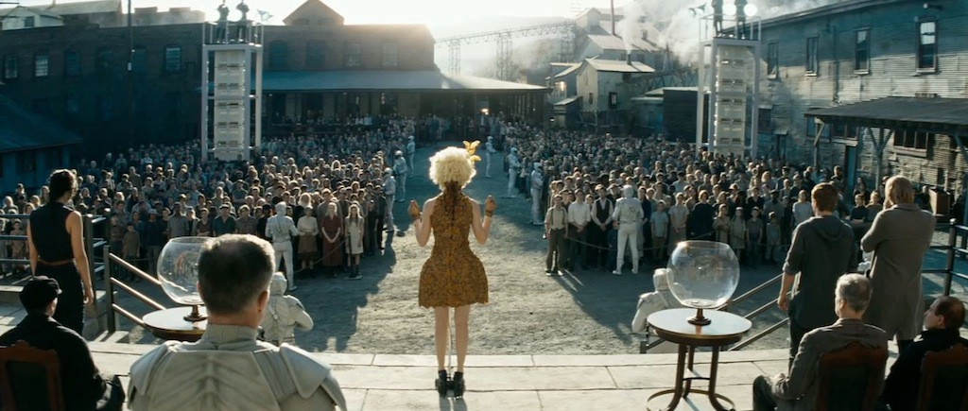
Survey Sampling
19

Slide 21
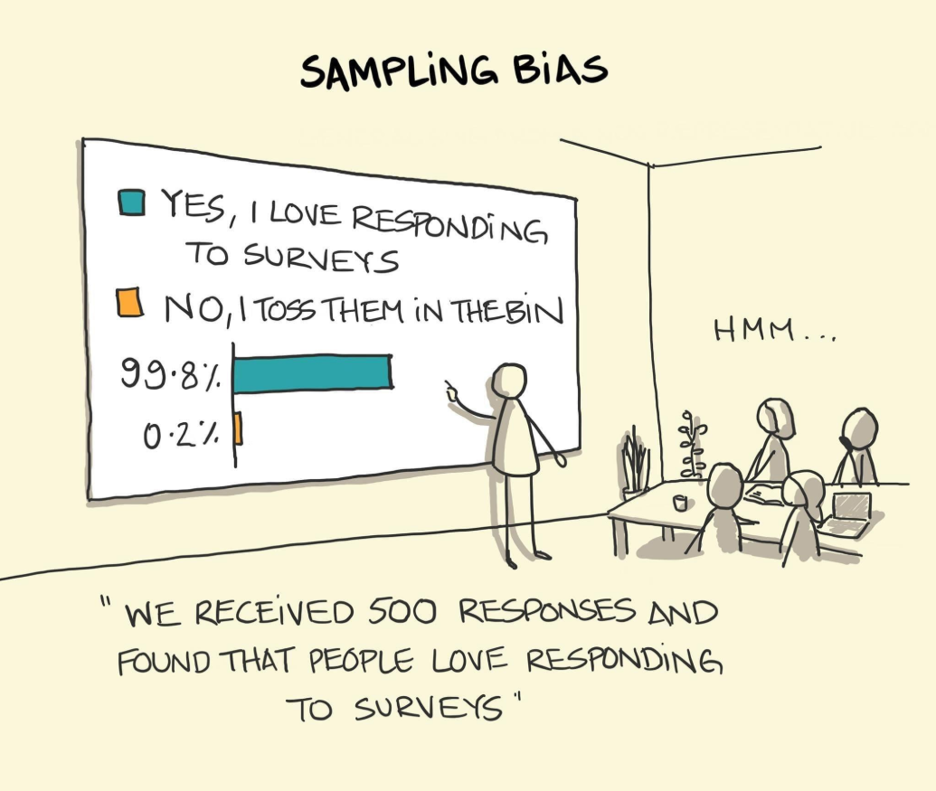
What is it?
The proper way to select your target audience
Selection of participants for a population
Census: Surveying all members of a population
In most cases, this is not possible
Notes:
-For your CW and due to the current situation this may (or may not) be, but at least you have to state the intention!

Slide 22
Key features
Representativeness
Flexibility
Effectiveness
Consistency
Diversity
Transparency
Probabilistic or non-probabilistic?
Notes:
Flex = Cover large geographic areas

Slide 23
Probabilistic Sampling
Every individual of the population has a non-zero chance of being selected
Ensures representativeness
Three sub-categories:
Random
Systematic
Stratified

Slide 24
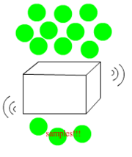
Random Sampling
Used when identifying characteristics is (almost) impossible
Sample selected independently of others
Equal chance of being selected as subject when sampling
Advantage: Reduce bias
Issue: It may be biased already without you knowing! (e.g. phone polling)
https://alevel-sociology.fandom.com/wiki/Simple_random_sample

Slide 25
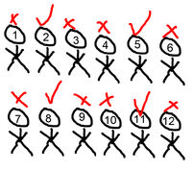
Systematic Sampling
The proposed location is logically homogenous
First decide sample size, then arrange elements to select members at regular intervals
Good as random sampling if there is no hidden order
Issue: Periodicity tends to create patterns
Solution: Randomise before sampling
Notes:
In the case of the phone polls, these would get rid of the bias as it will resort all numbers and then take samples randomly

Slide 26
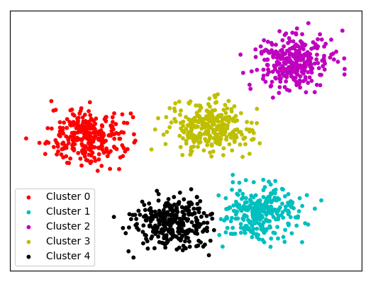
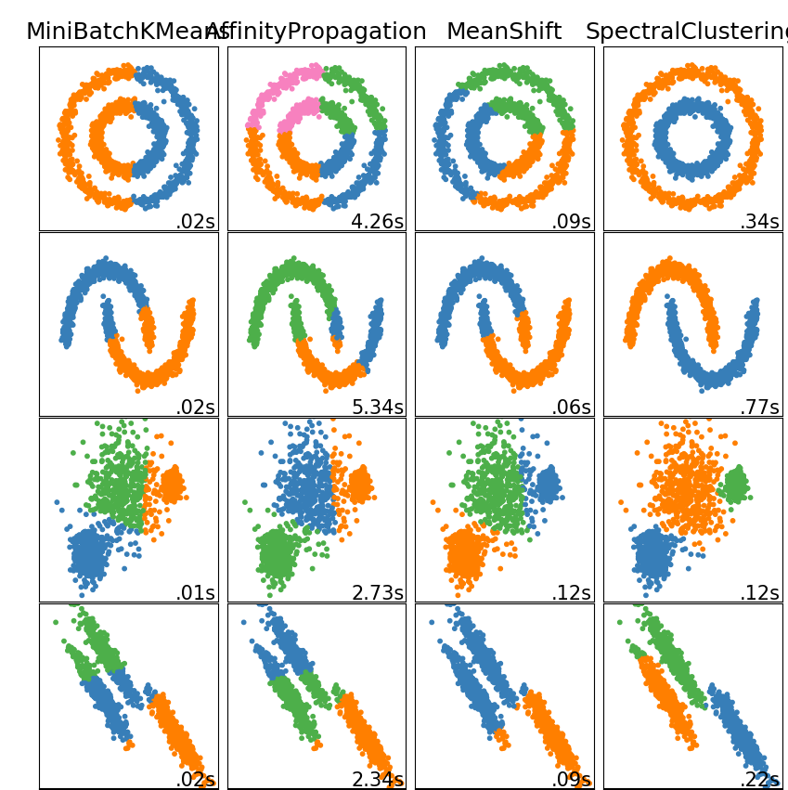
Stratified Sampling
You divide the population into groups of characteristics (depending on focus)
Then you sample within each category and select randomly
Issue: More complex
Solution: Machine learning!
Notes:
-In machine learning there are methods called unsupervised learning which let you train a classifier to cluster data
-The problem is that there are many of these methods, and they cluster differently!

Slide 27
Non-Probabilistic Sampling
Samples are collected with no specific structure in mind
Ensures practicality
Three sub-categories:
Convenience
Snowball
Quota
Notes:
You apply these methods when you don’t have the choice to do probabilistic ones!

Slide 28
Convenience Sampling
Samples are selected based on availability and accessibility (to the test)
Created rapidly without extra load
Issues: Poor representativeness, should only be used as an approach!

Slide 29
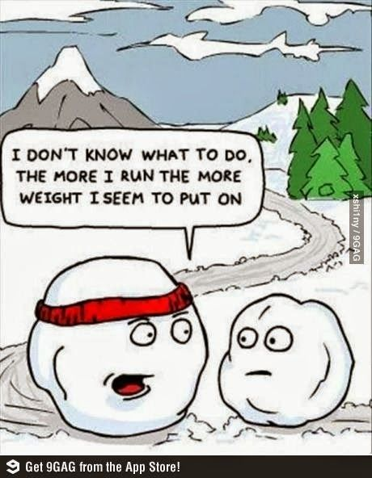
Snowball Sampling
Select an individual, and then this leads you to someone else.
Used in academic research (not as you may think!)
Advantage: Low cost, high relevance
Issues: Homogeneity
Notes:
-You tend to pick from the same group!

Slide 30
Quota Sampling
You need your sample to be of certain features
(In a way) equivalent to stratified
Superior to the previous two, but doesn’t have any statistical insight

Slide 31
So which one is this?!

Slide 32
Planning Surveys
31

Slide 33
How to start?
State a question, pose a problem
State the hypothesis
Plan your study
What do you want to find?
Which is the basis of comparison?
How will you measure?
Which are the users (sample)
Which tool to use?
You will need to … results
Summarise
Analyse
Visualise
Interpret
Discuss

Slide 34
The central principle
A good evaluation captures qualitative and quantitative data
It establishes a proper scale for each!
Which is best?
The proper one to get the most reliable data
Mix approaches

Slide 35
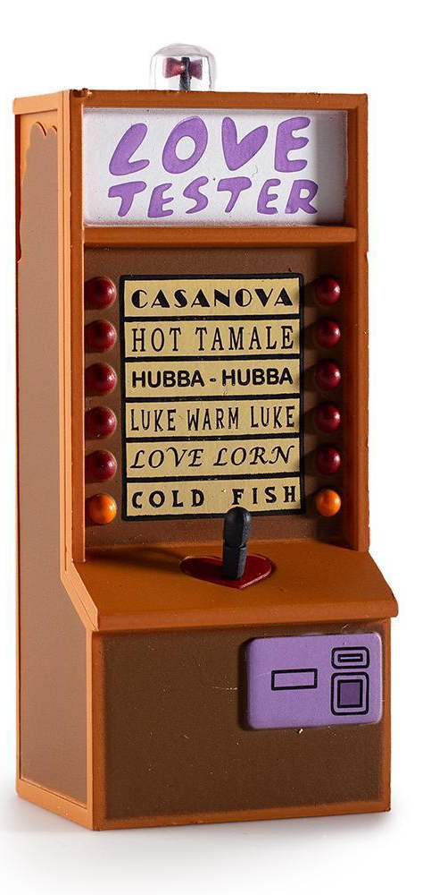
Scales
The measurements that you choose influence on the participants’ responses
Types of scales:
Nominal: Used for tally
Membership, characteristics, etc
Ordinal: Same, but with an order
Never – Sometimes – Always
Interval: There is an unclear scaling
Never 1 2 3 4 5 6 7 Always
Ratio/Continuous: Score
Retrofit?
Notes:
-Sometimes you have to adjust your scales to others (example of British obesity studies using stone)

Slide 36
Statistics
35

Slide 37
Reporting Counts
Nominal and ordinal counts have to be summarised
Tally each response
Average frequency of each category
You can discuss this!
Interval
Summarised
Compared between levels (as if it were ordinal)
Stats are limited
Ratio/Continuous
Summarised
Stats can be applied

Slide 38
Counting
Simplest form to measure things → frequency analysis
Can be applied to different types of data
You can convert to a percentage

Slide 39
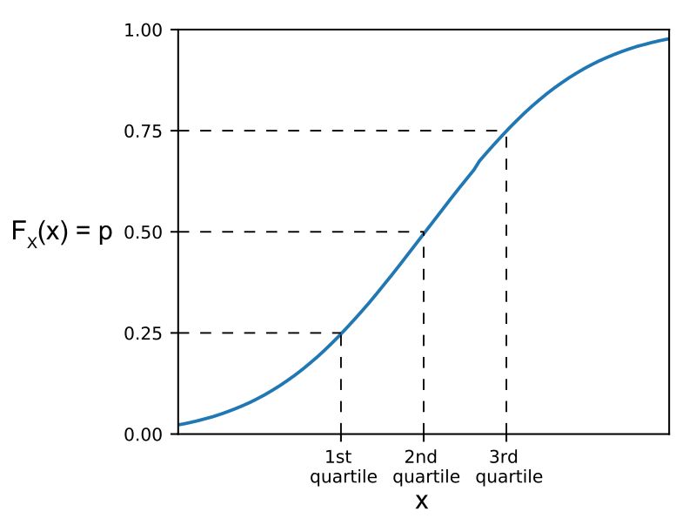
Quartiles
A type of quantile/percentile (i.e. way to split counts) which divides data points into four (more or less) equal parts
Q1 would be the top 25%, Q2 the following 25% and so on…
Used by the Journal Citation Reports (JCR) to see which are “the best” journals
Based on this definition,
the figure would be missing Q4!
Notes:
-Quantile is how you measure in parts, quartile is measuring in four parts
-For instance in Spain you can only “keep” your academic job if you publish in Q1
-Be careful as this definition may differ, for instance other sources (https://en.wikipedia.org/wiki/Quartile) only use Q1, Q2 and Q3!

Slide 40
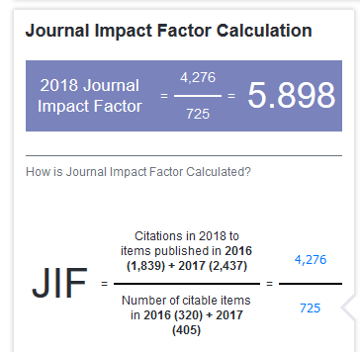
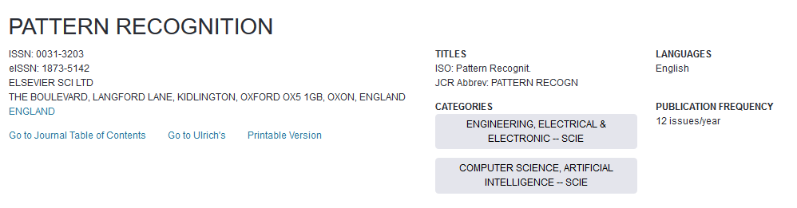
Example from JCR

Slide 41
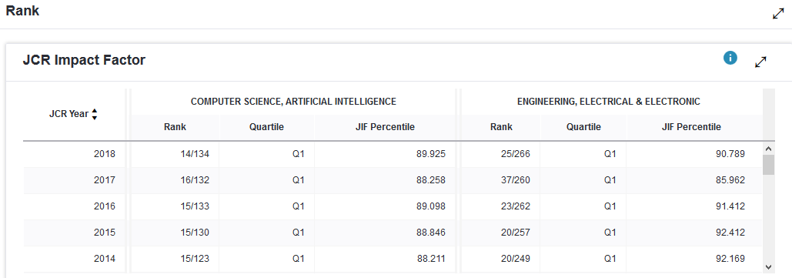
Example from JCR

Slide 42
Measures of Central Tendency
Arithmetic mean
Variance & Standard Deviation
Median
Mode

Slide 43
Final Tips
Do I have sufficient data to extract the measures?
Is my data of any distribution
Is the data sufficiently skewed so that these are representative?
Notes:
-If you have 10 study answers, maybe there is no point on obtaining certain measurements
-Plot your data first!
-What’s the point of obtaining the std. of data where everyone answered the same!

Slide 44
Demo (Python)
Go to Moodle to download the source files and to watch the video demo

Slide 45
Lab (Your do the same, using Excel!)

